Slide 1


TOPIC: Quadratic Roots
EQ: How do I find the roots of a quadratic using the quadratic formula?
$$Example: x^{2}−5x−9=0$$
First thing you do is label you’re a, b and c. a and b are coefficients and c is your constant
a = 1
b = -5
c = -9
You now need to determine the discriminant:
$${Formula: b}^{2}−4×a×c$$

Slide 2
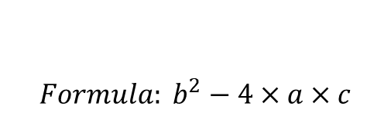
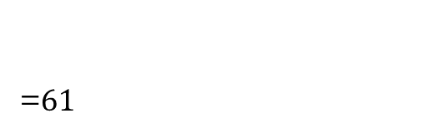
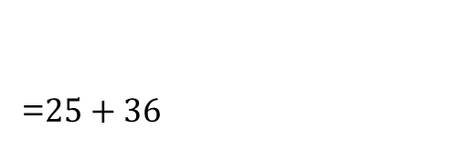
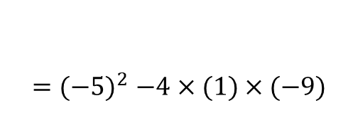
TOPIC: Quadratic Roots
EQ: How do I find the roots of a quadratic using the quadratic formula?
$$Example: x^{2}−5x−9=0$$
$${Formula: b}^{2}−4×a×c$$
$${=(−5)}^{2}−4×(1)×(−9)$$
=$25+36$
=$61$
We now know the discriminant is 61, so its not a square number

Slide 3
TOPIC: Quadratic Roots
EQ: How do I find the roots of a quadratic using the quadratic formula?
$$Example: x^{2}−5x−9=0$$
$${Formula: b}^{2}−4×a×c$$
$${=(−5)}^{2}−4×(1)×(−9)$$
=$25+36$
=$61$

Slide 4

TOPIC: Quadratic Roots
EQ: How do I find the roots of a quadratic using the quadratic formula?
$$Example: x^{2}−5x−9=0$$
We get the general rule for the solutions to all quadratic equations with what we call the QUADRATIC FORMULA
$$x=\frac{−b±\sqrt{b^{2}−4ac}}{2a}$$

Slide 5

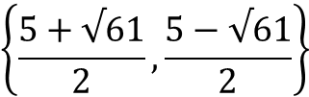
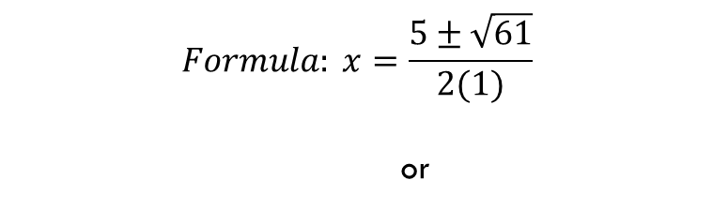
TOPIC: Quadratic Roots
EQ: How do I find the roots of a quadratic using the quadratic formula?
$$Example: x^{2}−5x−9=0$$
$$Formula: x=\frac{−b±\sqrt{b^{2}−4ac}}{2a}$$
$$Formula: x=\frac{5±\sqrt{61}}{2(1)}$$
or
$$\left\{\frac{5+√61}{2}\right.,\left.\frac{5−√61}{2}\right\}$$

Slide 6

TOPIC: Quadratic Roots
EQ: How do I find the roots of a quadratic using the quadratic formula?
Use the quadratic formula to solve $x^{2}+6x+8=0$
$$x=\frac{−b±\sqrt{b^{2}−4ac}}{2a}$$
It is easier to find the discriminant first!!
$${Formula: b}^{2}−4×a×c$$
$${=(6)}^{2}−4(1)(8)$$

Slide 7




TOPIC: Quadratic Roots
EQ: How do I find the roots of a quadratic using the quadratic formula?
Use the quadratic formula to solve $x^{2}+6x+8=0$
$$x=\frac{−b±\sqrt{b^{2}−4ac}}{2a}$$
$${Formula: b}^{2}−4×a×c$$
$${=(6)}^{2}−4\left(1\right)\left(8\right)$$
$$=4$$
$$x=\frac{−6±\sqrt{4}}{2(1)}$$
or

Slide 8


TOPIC: Quadratic Roots
EQ: How do I find the roots of a quadratic using the quadratic formula?
Use the quadratic formula to solve $x^{2}+6x+8=0$
$$x=\frac{−6±\sqrt{4}}{2(1)}$$
or
$$x=\frac{−6+2}{2}or x=\frac{−6−2}{2} \\ x=−\frac{4}{2}or x=−\frac{8}{2}$$
$$x=−2 or −4$$

Slide 9

LHS
Use the quadratic formula to solve:
$x^{2}−8x−20=0$

Slide 10
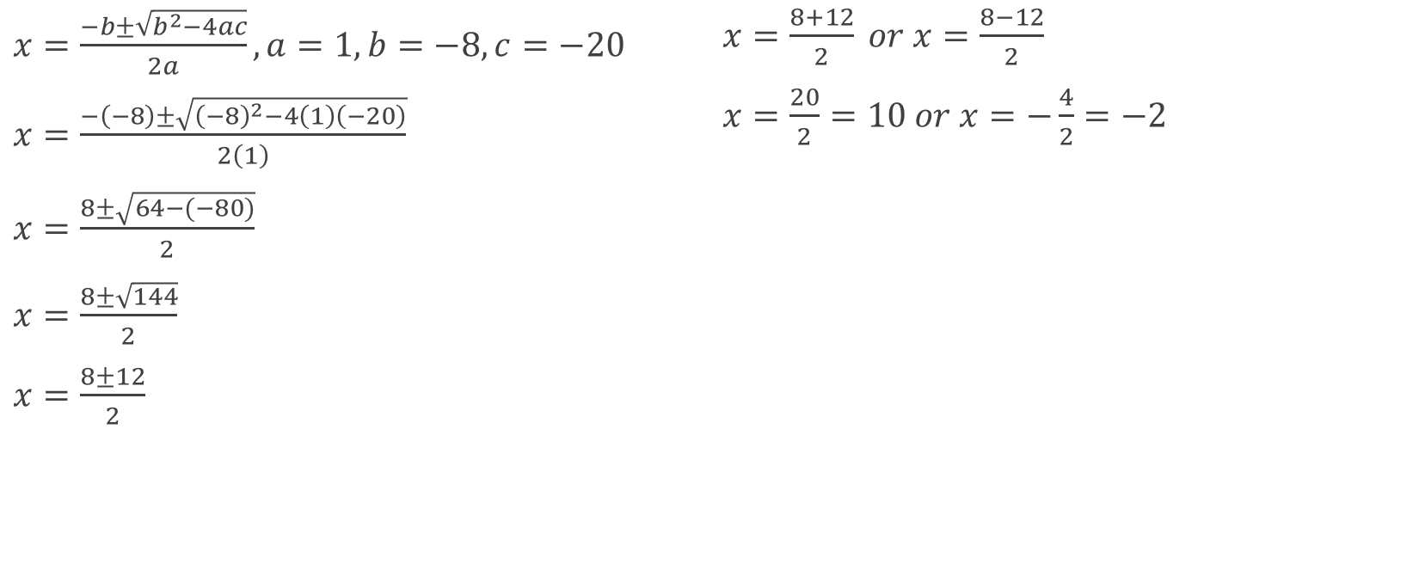

Solution ($x^{2}−8x−20=0$)
$x=\frac{−b±\sqrt{b^{2}−4ac}}{2a}, a=1, b=−8, c=−20$
$x=\frac{−\left(−8\right)±\sqrt{{\left(−8\right)}^{2}−4\left(1\right)\left(−20\right)}}{2\left(1\right)}$
$x=\frac{8±\sqrt{64−(−80)}}{2}$
$x=\frac{8±\sqrt{144}}{2}$
$x=\frac{8±12}{2}$
$x=\frac{8+12}{2} or x=\frac{8−12}{2}$
$x=\frac{20}{2}=10 or x=−\frac{4}{2}=−2$
In this equation, they solve everything in one equation!
I would still solve the discriminant first!
$$b^{2}−4ac$$
$${\left(−8\right)}^{2}−4\left(1\right)\left(−20\right)$$

